Slide 1
Randomly Failed!
The State of Randomness in Current Java Implementations
Kai Michaelis, Chris Meyer, Jörg Schwenk
Horst Görtz Institute for IT-Security (HGI)
Chair for Network and Data Security
Ruhr-University Bochum, Germany
CRYP-W25
Advanced
Notes:
Introductory questioning:
Who of the audience uses Java?
Who of the audience uses Android or Blackberry mobile phones (these ones are possibly using Java without even knowing it)?
Rethorical question on how “random” are the PRNGs of these devices.
Motivation: What this talk is about affects most of the people’s every-day-devices!

Slide 2
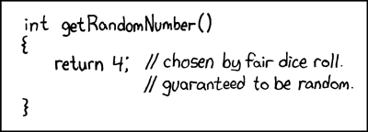
How Random are Java PRNGs?
Source: http://www.xkcd.com
Notes:
Purpose of this slide:
Reducing tension
Getting attention
(try to get the audience - some kind of - comfortable with the topic)

Slide 3

Spoiler Slide
At least, thankfully not!
  Inspected PRNGs
    Apache Harmony
    GNU Classpath
    OpenJDK
    The Legion of Bouncy Castle
  Methodology
    Code/algorithm inspection
    Blackbox Tests (Dieharder, STS, …)
  Broad range of code/algorithm quality
    The good
    The bad
    And the ugly
Source: http://www.memegenerator.net
Notes:
Short lineup and brief summary of the results without revealing details or hints on which ones are the good, the bad and the ugly implementations
Distinction what this talk is about and what not (Blackbox tests are left out since it seems boring to me to give lengthy introductions on tests, test methods and taking readings of result tables to the audience)

Slide 4
Operation Sketch of a PRNG
Entropy Source A
Entropy Source B
Entropy Source C
Seed
Focus of inspection
Random number
Seeding
(normally invoked only once)
Generating pseudo-random numbers
(invoked multiple times)
Notes:
What was focus of inspection?
How do these components interact?
Why is it smarter to inspect seeds instead of the random numbers?

Slide 5
Results: Apache Harmony
PRNG
  SHA-1 based algorithm: Seed, Counter, Internal State
Backup seeding facility (Entropy Collector)
  (under Unix): Unix-Time, Processor Time, Pointer value (Heap)
Weaknesses
  Self-seeding SecureRandom suffers from implementation bug
    Pointer into state buffer not properly adjusted
    Entropy reduced to 64 bits
    Directly affects the Android platform
  Backup seeding facility (Entropy Collector) suffers from multiple implementation bugs
    MSB set to 0 (reason for this remains unclear)
    Inappropriate modular reduction (signed/unsigned integers)
    Entropy reduced to 31 bits (worst case)

Slide 6
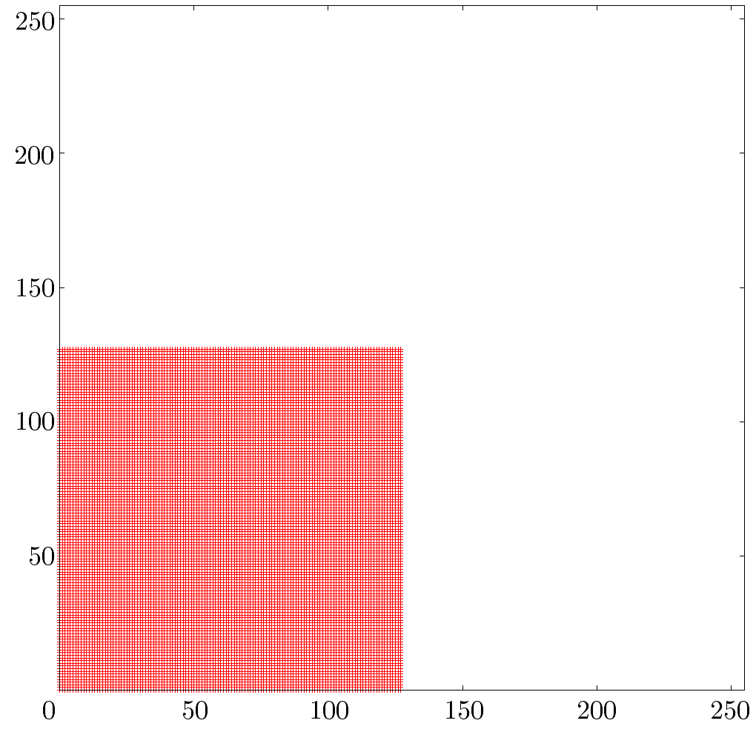
Results: Apache Harmony
Quality of Entropy Collector
Worst-Case scenario
2 consecutive bytes
mark a single point
10 MiB generated Seed

Slide 7
Results:GNU Classpath
PRNG
  SHA-1 based algorithm: Seed, Internal State
Backup seeding facility (Entropy Collector)
  8 Threads increment independent counters (c1..c8)
  Seed = c1 XOR c2 XOR …. c8
Weaknesses
  Repeated use of same IV
    Predictable internal states: only 20 of 32 bytes unknown
  Backup seeding facility (Entropy Collector) can be influenced
    High load prevents threads execution

Slide 8
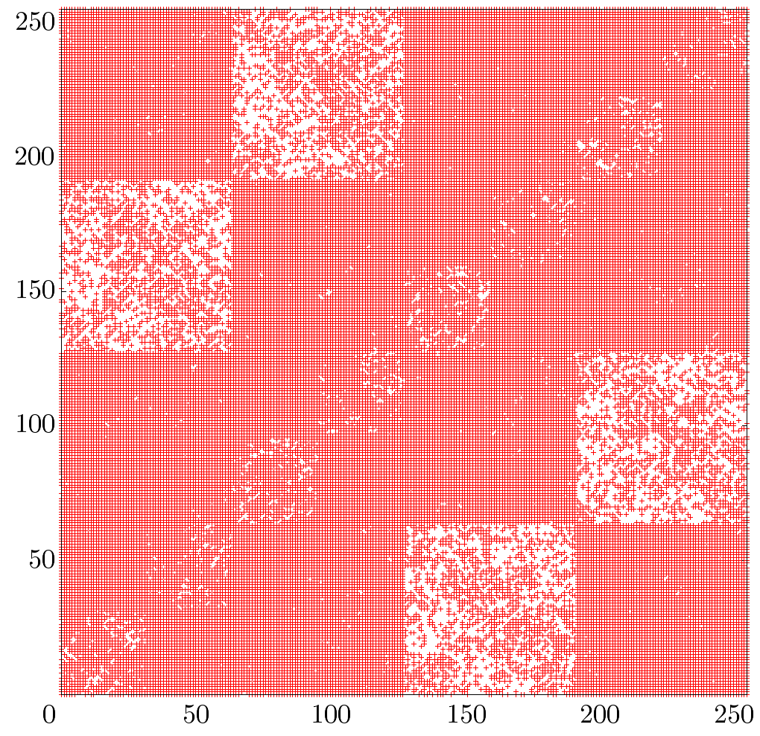
Results: GNU Classpath
Quality of Entropy Collector
Worst-Case scenario
2 consecutive bytes
mark a single point
10 MiB generated Seed

Slide 9
Results: OpenJDK
PRNG
  SHA-1 based algorithm: Seed, Internal State, Fixed-state protection
Backup seeding facility (Entropy Collector)
  Counter incrementation, System.properties
  Noise threads (keep the scheduler busy)
  S-Boxing counter
  Enforcing mandatory runtime and counter incrementation
  Slow….
Weaknesses
    No obvious weakness

Slide 10
Results: Bouncy Castle
PRNG
  Multiple SecureRandom replacements
    SHA-1 based algorithm: Seed, Internal State, Counter
    VMPC based algorithm
Backup seeding facility (Entropy Collector)
  Counter incrementation
  Producer and Consumer Threads
  Slow and fast operation mode
Weaknesses
  VMPC known to be vulnerable to distinguishing attacks

Slide 11
Conclusion
PRNGs are only as good as the seed’s entropy
Software Entropy Collectors are mostly not suitable for cryptographic purposes
Broad range of code/algorithm quality
Fixed & limited size of internal states
Some implementations are only susceptible to the outlined vulnerabilities if no OS entropy is available
Personal advice
  In critical environments
    Prevent usage of PRNGs
    Exclusively rely on hardware ECs/RNGs
Notes:
Software Entropy Collectors: Entropy not random at all, can mostly be influenced
Limited state size: OpenJDK & GNU Classpath rely on 160bit → no enhanced security when e.g., generation 256bit AES keys

Slide 12


Random Questions?
Chris Meyer
Christopher.meyer@rub.de
http://armoredbarista.blogspot.com
http://www.nds.rub.de/chair/people/cmeyer
Source: http://www.troll.me

